Slide 1

Deploy Titanic Model

Slide 2
HTTP Request method
Common HTTP request methods:
- GET: Retrieve data from the server.
- POST: Submit data to be processed to a specified resource.
- PUT: Update a resource or create a new resource if it does not exist.
- DELETE: Request the removal of a resource.

Slide 3
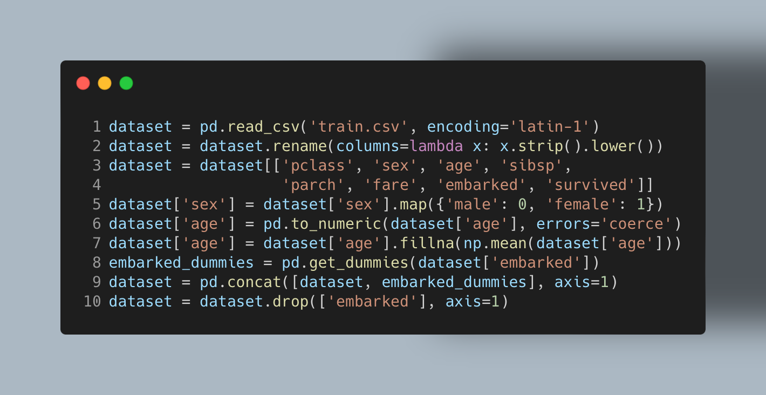
Model Overview

Slide 4
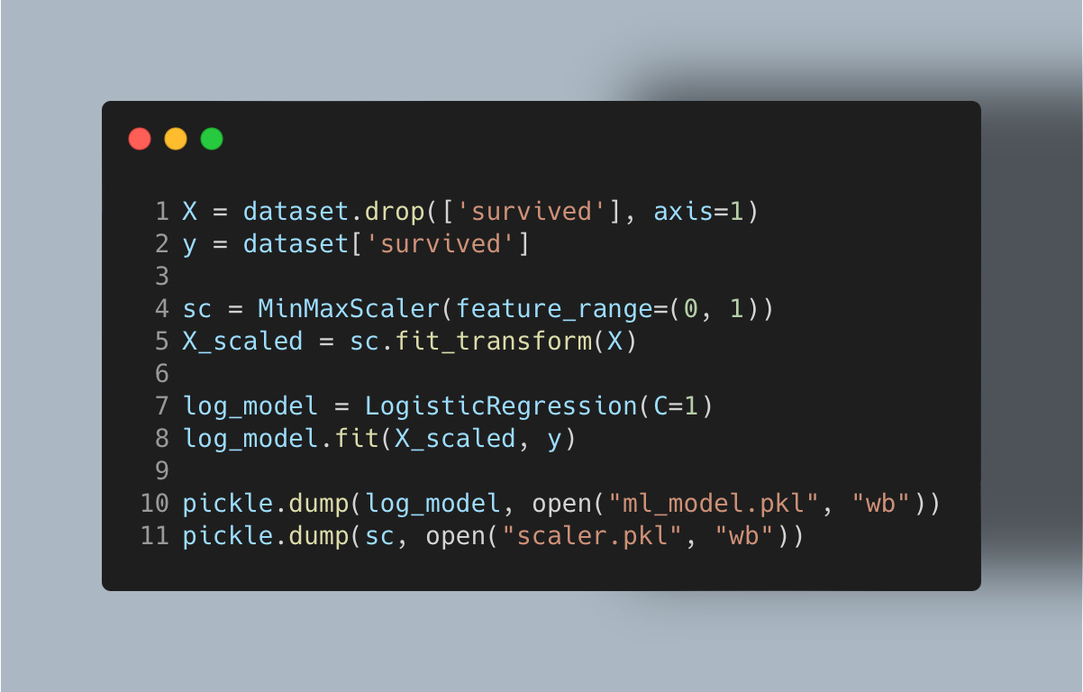
Model Overview

Slide 5
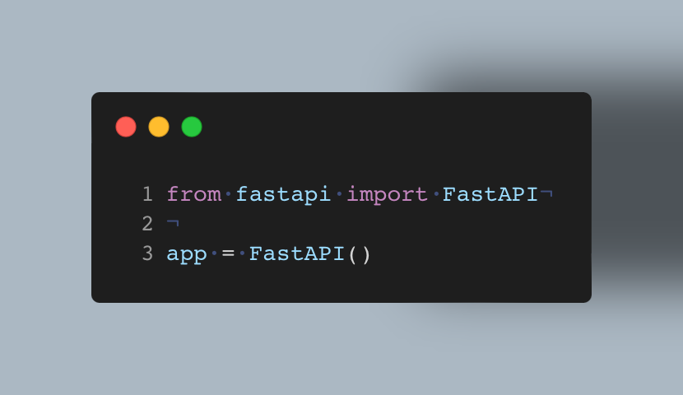
Define FastAPI Instance

Slide 6
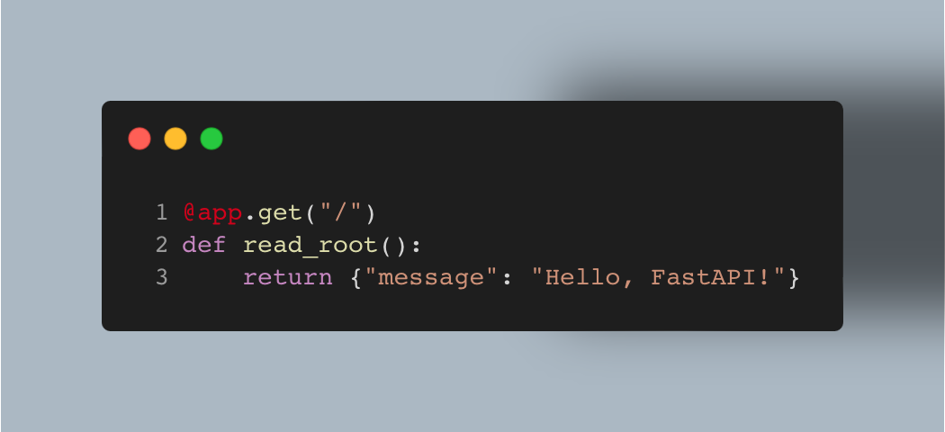
Welcome Page

Slide 7
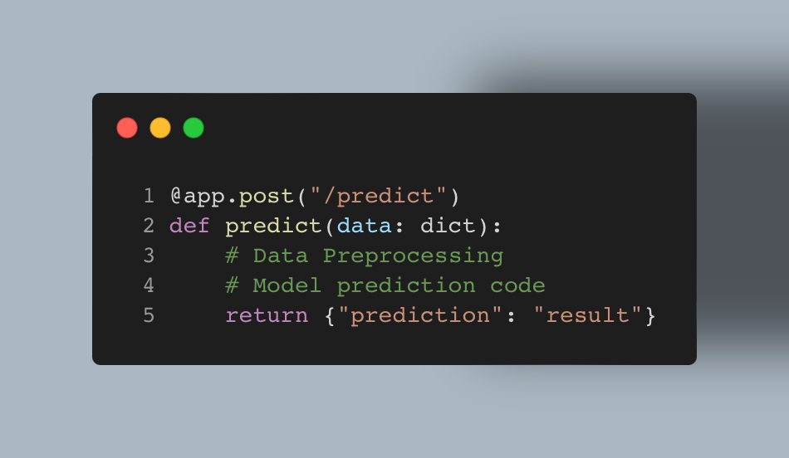
Define Predict Function

Slide 8
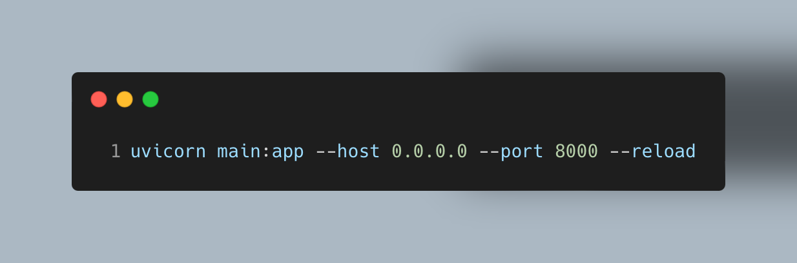
Run Your Server

Slide 9
Thank You

